Slide 1
Object-oriented Analysis &Design
面向对象分析与设计
Lecture_03 Domain model
Presenter: Xiaohong Chen
陈小红
2020/9/22

Slide 2
学习要点：
Domain models（领域模型）
  Identify conceptual classes.
  Model appropriate attributes and associations.

Slide 3

回顾-类图(Class diagram)

Slide 4
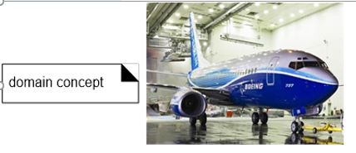
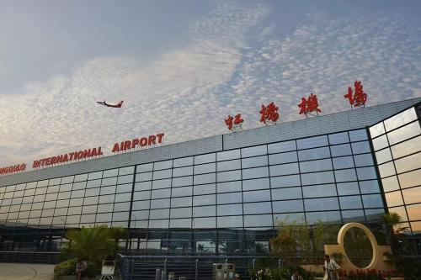
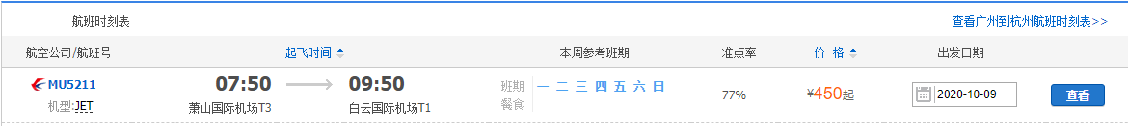
What is a Domain Model
A conceptual model， a representation of concepts in a problem domain.
Airport
Plane
Flight: MU5211 Flight Description

Slide 5
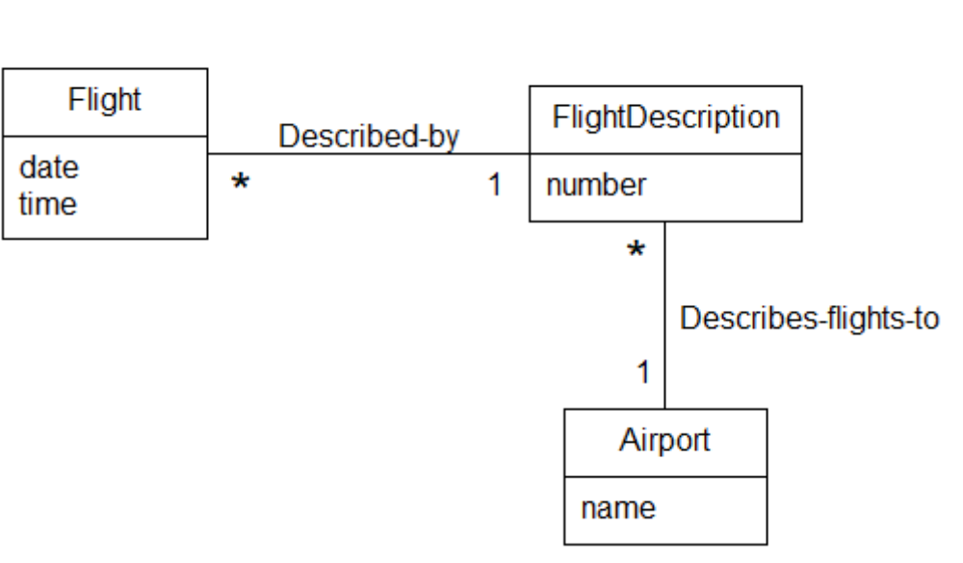
How to visually represent ‘Conceptual class?
In UML it is basically a “class diagram without operations”.
It may show:
  Concepts
  Associations of concepts
  Attributes of concepts

Slide 6
How to construct a domain model?
3 Things /steps
Attribute
concepts
Association

Slide 7
A process for constructing
Find the concepts
Draw them in a conceptual model
Add associations
Add attributes

Slide 8
How to identify concepts
Reuse or modify existing models.
  This is the first, best, and usually easiest approach, and where I will start if I can.
Finding Concepts with the Concept Category List.
Finding Concepts with Noun Phrase Identification.
Text book, section 9.5
A central distinction between object oriented and structures analysis:
  division by concepts (objects) rather than division by functions.
Notes:
Text book, section 9.5
There are three strategies to find conceptual class.
First method is outside our scope. We’ll focus on the second and the third.

Slide 9
The Concept Category List
Table 1. Conceptual Class Category List.
Conceptual Class Category | Examples
business transactions Guideline: These are critical (they involve money), so start with transactions. | Sale, Payment Reservation
transaction line items Guideline: Transactions often come with related line items, so consider these next. | SalesLineItem
product or service related to a transaction or transaction line item Guideline: Transactions are for something (a product or service). Consider these next. | Item Flight, Seat, Meal
where is the transaction recorded? Guideline: Important. | Register(收银台), Ledger(分类帐) FlightManifest
roles of people or organizations related to the transaction; actors in the use case Guideline: We usually need to know about the parties involved in a transaction. | Cashier, Customer, Store, MonopolyPlayer Passenger, Airline
place of transaction; place of service | Store, Airport, Plane, Seat
To continue
Notes:
Text book, section 9.5
ledger [简明英汉词典]
[5ledVE]
n.[会计]分类帐, 分户总帐, 底帐, [建](手脚架上的)横木

Slide 10
noteworthy events, often with a time or place we need to remember | Sale, Payment MonopolyGame, Flight
physical objects Guideline: This is especially relevant when creating device-control software, or simulations. | Item, Register Board, Piece, Dice, Airplane
descriptions of things | ProductDescription FlightDescription
catalogs Guideline: Descriptions are often in a catalog. | ProductCatalog FlightCatalog
containers of things (physical or information) | Store, Bin Board Airplane
things in a container | Item Square (in a Board) Passenger
other collaborating systems | CreditAuthorizationSystem AirTrafficControl
records of finance, work, contracts, legal matters | Receipt, Ledger MaintenanceLog
financial instruments | Cash, Check, LineOfCredit TicketCredit
schedules, manuals, documents that are regularly referred to in order to perform work | DailyPriceChangeList RepairSchedule

Slide 11
Finding Concepts with
Noun Phrase Identification
Identify the noun and noun phrases in textual descriptions of a problem domain and consider them as candidate concepts or attributes.
Care must be applied with this method.
  A mechanical noun-to-concept mapping is not possible !
Description
Concepts
The system controls a recycling machine
the value of the returned items and the total return sum that will be paid to the customer.
system
recycling machine
the value
returned items
total return sum customer
?

Slide 12
Case Study: Nouns in
The Recycling machine -
The “return item” Use case.
The system controls a recycling machine for returnable bottles, cans and crates(板条箱). The machine can be used by several customers at the same time and each customer can return all three types of item on the same occasion. The system has to check, for each item, what type has been returned.
The system will register how many items each customer returns and when the customer asks for a receipt, the system will print out what was deposited , the value of the returned items and the total return sum that will be paid to the customer.
An operator also … (not in “return item” Use Case)
Notes:
crate
[kreit]
n.
板条箱, 柳条箱

Slide 13
Case Study: Nouns in
The Recycling machine -
The “return item” Use case.
The system controls a recycling machine for returnable bottles, cans and crates. The machine can be used by one customer at the same time and each customer can return all three types of item on the same occasion. The system has to check, for each item, what type has been returned.
The system will register how many items each customer returns and when the customer asks for a receipt, the system will print out what was deposited , the value of the returned items and the total return sum that will be paid to the customer.
An operator also … (not in “return item” Use Case)
Notes:
The machine can be used by several customers at the same time
这个例子我感觉不好，跟真实的要做的事情冲突。。。比如会画machine

Slide 14
Case Study: Nouns found in the description
recycling machine
bottles, cans, and crates
machine
customer
types of item, item, type, returned items
system
receipt
return sum

Slide 15
Case Study:
Discussion of “recycling machine”.
recycling machine
bottles, cans and crates
machine
customer
types of item, item, type, returned items
system
receipt
return sum
This concept is the “overall system”. As we consider only one single use case, it is better to name this concept in the context of this use case, e.g.
  Deposit item receiver

Slide 16
Case Study:
Discussion of “bottles, cans, and crates”.
deposit item receiver
bottles, cans, and crates
machine
customers, customer
types of item, item, type returned items
system
receipt
return sum
In a conceptual model it is usually better to use singular and multiplicities instead of plural.
As bottle, can and crate have much in common (they are processed as items), they could be generalised to an “item”.
We should remember this for later (inheritance).

Slide 17
Case Study:
Discussion of “machine” and “system”.
deposit item receiver
bottle, can, crate
machine
customer
types of item, item, type, returned items
system
receipt
return sum
“Machine” and “System” mean here the same, namely the “Recycling machine”, i.e. the
  Deposit item receiver

Slide 18
Case Study:
Discussion of “customers” and “customer”.
deposit item receiver
bottle, can, crate
customer
types of item, item, type, returned items
receipt
return sum
The customer has already been identified as an actor.
They are outside of the system.

Slide 19
Case Study:
Discussion of “item” (etc.).
deposit item receiver
bottle, can, crate
customer
types of item, item, type, returned items
receipt
return sum
The items that are inserted in the machine.
Good candidate as superclass for bottle, can, crate.
Let’s call it
  Deposit item, ( instead of ‘item’)

Slide 20
Case Study:
Discussion of “receipt”.
deposit item receiver
bottle, can, crate
customer
deposit item
receipt
return sum
The concept that “remembers” all items inserted in the machine.

Slide 21
Case Study:
Discussion of “return sum”.
deposit item receiver
bottle, can, crate
customer panel
deposit item
receipt
return sum
The sum that it is returned to the customer is actually computed by adding up all values of the items stored in the receipt basis.
The sum itself is only a primitive data value, and may therefore not be considered as a concept.

Slide 22
Case Study:
Discussion of other concepts.
deposit item receiver
bottle, can, crate
customer panel
deposit item
receipt
These are the concepts identified by nouns. Did we forget something?

Slide 23

Case Study:
Discussion of other concepts.
These are the concepts identified by nouns. Did we forget something?
Check the
“Concept Category List” !
The system “interfaces” with the physical object “printer”, so we add an interface concept
  Receipt printer
deposit item receiver
bottle, can, crate
customer
deposit item
receipt
The system will print out what was deposited.

Slide 24
Case Study:
Summary of concepts identified in the analysis
deposit item receiver
bottle, can, crate
customer
deposit item
receipt
receipt printer
So far we have identified:
  Concepts
  A generalisation relationship.
Next step: Finding associations.

Slide 25
How to make a conceptual model.
Find the concepts
Draw them in a conceptual model
Add associations
Add attributes

Slide 26
Drawing of Concepts
Customer
Deposit item receiver
Deposit item
Receipt printer
Receipt
Can
Bottle
Crate

Slide 27
How to make a conceptual model.
Find the concepts
Draw them in a conceptual model
Add associations
Add attributes

Slide 28
Adding Associations
If one concept needs to know of another concept for some duration, they should be linked by an association.
    Add “Adornment” to association
Also use the following list in order to identify associations.

Slide 29
Common Association List(Ch 9.14)
A is a part of B
A is contained in B
A is a description for B
A is a line item of B
A is known or reported in B
A is a member of B
A is a organisational subunit of B
A uses or manages B
A communicates with B
A is related to a transaction B
A is a transaction related to another transaction B
A is next to B
A is owned by B

Slide 30
Adding associations
The Customer communicates to the receiver when an item is inserted.
Also when the receipt is requested.
Customer
initiates action
Deposit item receiver
Deposit item
Receipt printer
Receipt
Can
Bottle
Crate

Slide 31
Adding associations
The Deposit item receiver manages Deposit items:
  The items are classified.
Customer
initiates action
Deposit item receiver
classifies
Deposit item
Receipt
Receipt printer
Can
Bottle
Crate
<number>/77

Slide 32
Adding associations
The Deposit item receiver communicates to Receipt basis:
Items received and classified are stored.
It also creates the receipt when it is needed for the first time.
Customer
initiates action
Deposit item receiver
creates & notifies
classifies
Deposit item
Receipt
Receipt printer
Can
Bottle
Crate
<number>/77

Slide 33
Adding associations
The Receipt basis captures Deposit items.
Customer
initiates action
Deposit item receiver
creates & notifies
classifies
captures
Deposit item
Receipt
Receipt printer
Can
Bottle
Crate
Notes:
The Receipt basis collects Deposit items.

Slide 34
Adding associations
Customer
initiates action
Deposit item receiver
creates & notifies
classifies
captures
Deposit item
prints on
1..*
Receipt
Receipt printer
Can
Bottle
Crate
为什么Deposit item receiver、 Receipt、Receipt printer之间的关系是这样画的？

Slide 35
Adding associations
On request by the Customer, the Deposit item receiver initiates printing of a receipt on the printer.
Customer
initiates action
Deposit item receiver
creates & notifies
classifies
captures
Deposit item
prints on
Receipt
Receipt printer
Can
Bottle
Crate
为什么Deposit item receiver、 Receipt、Receipt printer之间的关系是这样画的？

Slide 36
Adding associations
Adding multiplicities
Only one association here is a 1 to many relationship
All others are 1 to 1.
Customer
initiates action
Deposit item receiver
creates & notifies
classifies
captures
Deposit item
prints on
1..*
Receipt
Receipt printer
Can
Bottle
Crate

Slide 37
Adding Attributes
An attribute is a logical data value of an object.
Attributes in a conceptual model are simple data values as
  Boolean, Date, Number, String (Text), Time, Address, Colour, Price, Phone Numbers, Product Codes, etc.
Sometimes it is difficult to distinguish between attributes and concepts (CH 9.12)
Sale
Sale
Store
store
Or …
phoneNum
Guideline
If we do not think of some conceptual class X as a
Number or text in the real world, X is probably a
Conceptual class, not an attribute.
?

Slide 38
Adding attributes
The Deposit item has a value.
Also it will be assigned a number that shows later on the receipt.
Customer
initiates action
Deposit item receiver
creates & notifies
classifies
captures
Deposit item
number
value
prints on
1..*
Receipt
Receipt printer
Can
Bottle
Crate

Slide 39
Adding attributes
In order to be classified by the Deposit item receiver each item has also a weight and a size.
However this is the same for each type of item, but different between the types.
Customer
initiates action
Deposit item receiver
creates & notifies
classifies
captures
Deposit item
number
value
prints on
1..*
Receipt
Receipt printer
Can
weight
size
Bottle
weight
size
Crate
weight
size
<number>/77

Slide 40
Summary
NOT in a conceptual model:
  arrows
  dotted lines
  methods, operations, functions
Customer
initiates action
Deposit item receiver
creates & notifies
classifies
captures
Deposit item
number
value
prints on
1..*
Receipt
Receipt printer
Can
weight
size
Bottle
weight
size
Crate
weight
size

Slide 41
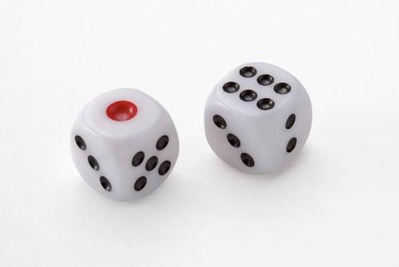
练习1: 名词短语识别-掷色子游戏(Dice game)
描述：我想要玩掷色子游戏，这个游戏需要两个色子。每次只要掷一下，看两个色子的值加起来是否为7，为7我就赢了，不为7我就输了。

Slide 42
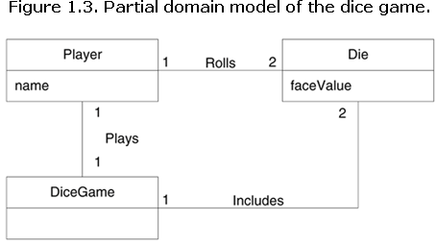
领域模型示例

Slide 43
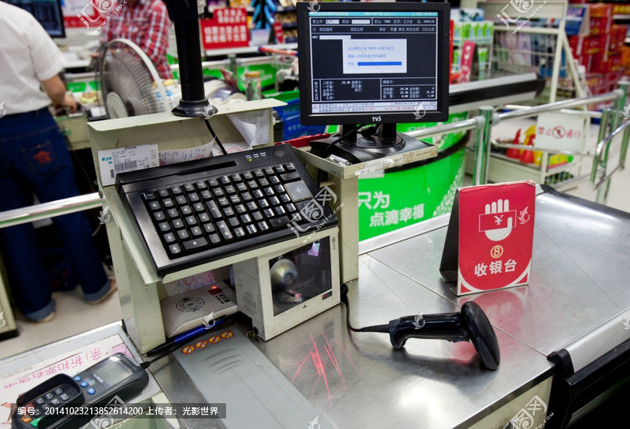
案例：POS

Slide 44
Basic Flow of POS
Customer arrives at POS checkout with goods and/or services to purchase.
Cashier starts a new sale.
Cashier enters item identifier.
System records sale line item and presents item description, price, and running total. Price calculated from a set of price rules.
Cashier repeats Customer the total, and asks for payment.
System presents total with taxes calculated.
Cashier tells Customer the total, and asks for payment.
Customer pays and System handles payment.
System logs completed sale and sends sale and payment information to the external Accounting systems and inventory system.
System presents receipt.
Customer leaves with receipt and goods (if any).

Slide 45
From the Concept Category List
Table 1. Conceptual Class Category List.
Conceptual Class Category | Examples
business transactions Guideline: These are critical (they involve money), so start with transactions. | Sale, Payment Reservation
transaction line items Guideline: Transactions often come with related line items, so consider these next. | SalesLineItem
product or service related to a transaction or transaction line item Guideline: Transactions are for something (a product or service). Consider these next. | Item Flight, Seat, Meal
where is the transaction recorded? Guideline: Important. | Register(收银台), Ledger(分类帐) FlightManifest
roles of people or organizations related to the transaction; actors in the use case Guideline: We usually need to know about the parties involved in a transaction. | Cashier, Customer, Store， MonopolyPlayer Passenger, Airline
place of transaction; place of service | Store, Airport, Plane, Seat
To continue
Notes:
Text book, section 9.5
ledger [简明英汉词典]
[5ledVE]
n.[会计]分类帐, 分户总帐, 底帐, [建](手脚架上的)横木

Slide 46
noteworthy events, often with a time or place we need to remember | Sale, Payment MonopolyGame, Flight
physical objects Guideline: This is especially relevant when creating device-control software, or simulations. | Item, Register Board, Piece, Die, Airplane
descriptions of things | ProductDescription FlightDescription
catalogs Guideline: Descriptions are often in a catalog. | ProductCatalog FlightCatalog
containers of things (physical or information) | Store, Bin Board Airplane
things in a container | Item Square (in a Board) Passenger
other collaborating systems | CreditAuthorizationSystem AirTrafficControl
records of finance, work, contracts, legal matters | Receipt, Ledger MaintenanceLog
financial instruments | Cash, Check, LineOfCredit TicketCredit
schedules, manuals, documents that are regularly referred to in order to perform work | DailyPriceChangeList RepairSchedule

Slide 47
POS Example: Create Domain Model
Step1: Conceptual classes in POS
Sale , Cashier , CashPayment, Customer
SalesLineItem , Store, Item, ProductDescription,
Register, ProductCatalog, Ledger
Step2: Association
Step3: Attribute

Slide 48
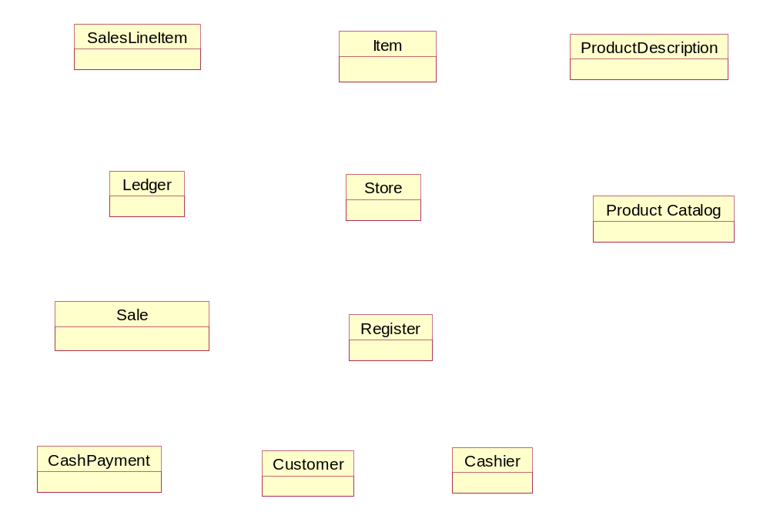
Association in POS
Records-sale-of
Describe
0..1
1..*
*
1
1..*
*
*
Contained-in
Stocks
Contains
1
Records- accounts-for
<- Used by
1
1
1
1
1
1
1
Logs Completed
1
Houses
*
Captured-on
1..*
0..1
1
1
1
1
Paid by
Is-for
Works on
1
1
1

Slide 49
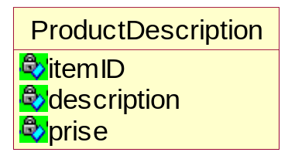
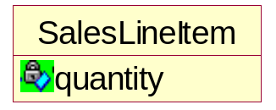
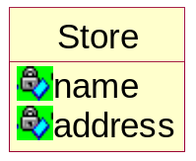
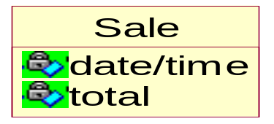
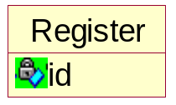
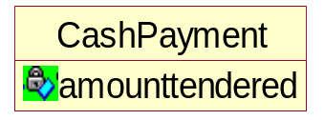
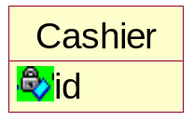
Attribute POS
Records-sale-of
Describe
0..1
1..*
*
1
1..*
*
*
Contained-in
Stocks
Contains
1
Records- accounts-for
<- Used by
1
1
1
1
1
1
Logs Completed
1
1
Houses
*
Captured-on
1..*
0..1
1
1
1
Paid by
1
Works on
Is-for
1
1
1
Notes:
顺序要调整一下。

Slide 50
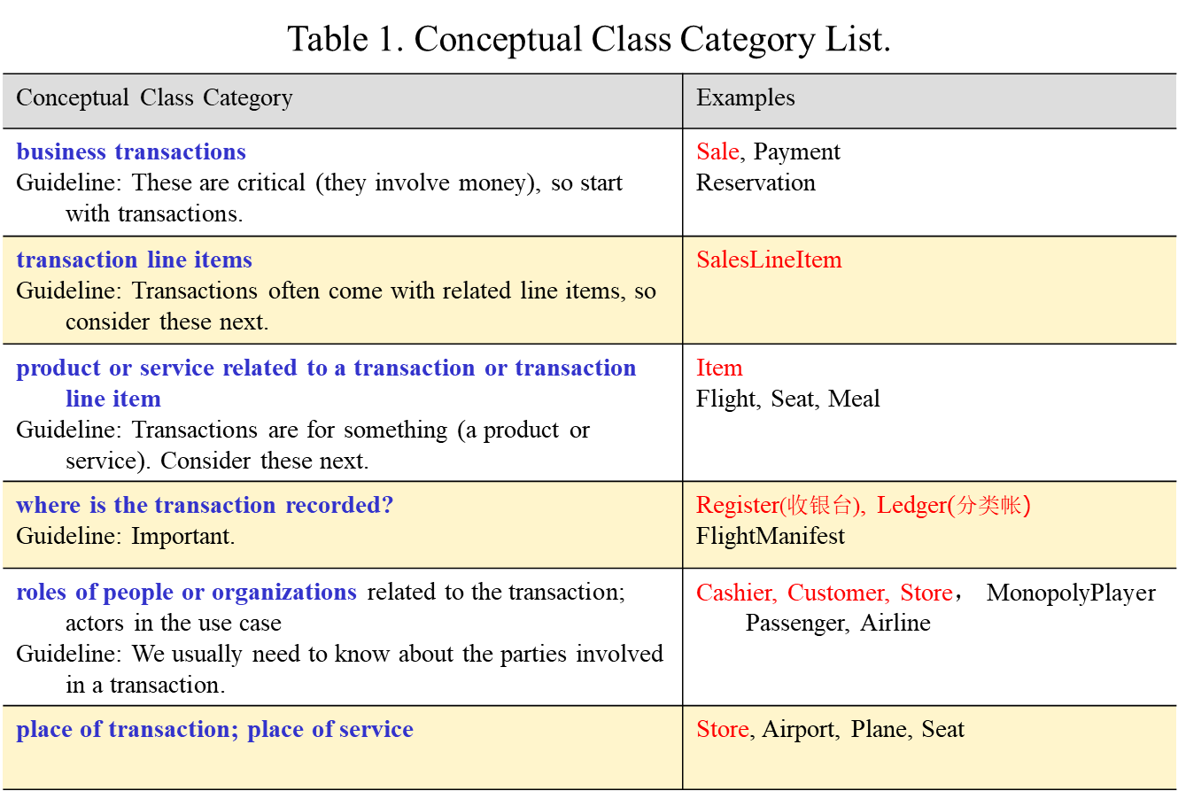
总结
是否可以总结一类适用的系统？？
Business Information System
Notes:
第一层拔高：订餐系统是否也类似
第二层拔高：通用型

Slide 51
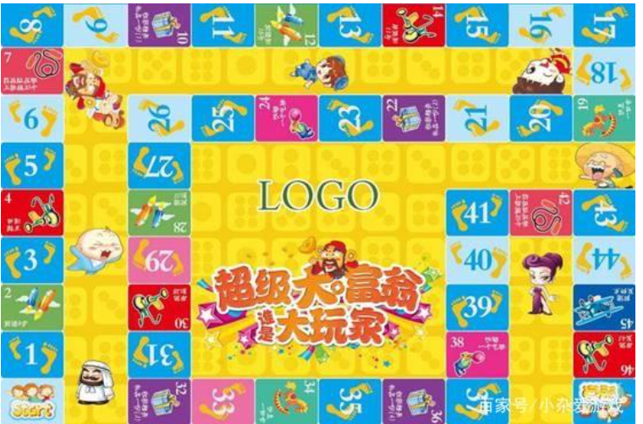
Monopoly Game

Slide 52
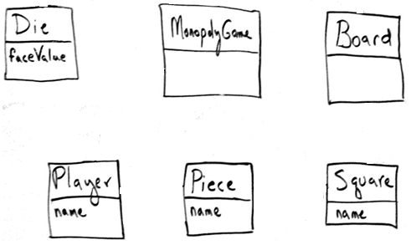
Monopoly Game

Slide 53
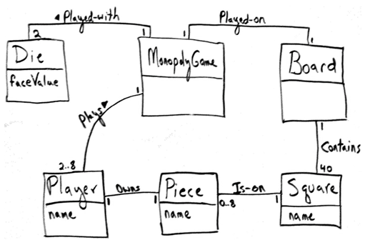
Monopoly Game
Dice: faceValue, after rolling the dice, needed to calculate the distance of a move.
Square: name , to print the desired trace output.

Slide 54
Summary -
Object Oriented Analysis-Classes
The main task is to identify the objects.
Also: Relationships between objects.

Slide 55
作业：
手抄一份POS以及Monopoly Game的domain model，请写出你认为这样画有什么好处？ 在绘制领域模型时，POS与Monopoly Game属于一类系统么？有什么区别？如果写不出来区别，就分别列举下你认为与他们类似的系统有哪些？
作业提交日期： 9.29日 课堂交
Notes:
分析一个“ATM取款机” (自定义需求)

Slide 56
End
Thank you!

